Slide 1
Development of a Multi-criteria based Tourist Place Recommendation System for the Bangladeshi People Using Machine Learning
Presented By :
Azmain Abid Khan
ID: 1704130
Supervised By :
Dr. Mahfuzulhoq Chowdhury
Associate Professor
Dept. of CSE, CUET

Slide 2
Contents
Introduction
Motivation
Related Works
Objectives
Methodology
Conclusion
References

Slide 3
Introduction
Plays a significant role in the economic development of a country [1]
Brings environmental, social and economical growth in Bangladesh in recent years
Many local and international tourists visit Bangladesh every year to observe the natural beauty
No clear information about the travel destination for the travelers according to budget, time, and interests
A mobile app can be used here to recommend the best place to travel

Slide 4
Motivation
Create many jobs, increase economic revenue, and evolve the infrastructures in Bangladesh
Plays a significant impact on the GDP of Bangladesh
From 2018-2019 it was 4.4 % of the total GDP [1] and From 2016-2017 it was 4.2 % of the total GDP [2]
In 2019, a total of 323,300 local and international tourists visited Bangladesh [3]
Need complete information about the travel destination for the travelers according to budget, time, and interests
Building a mobile app based system can provide help to the travelers
Using Multi-criteria based Tourist Place Recommendation System will help the travelers

Slide 5
Related Works
[2] –T. Ghani, N. Jahan, S. H. Ridoy, A. T. Khan, S. Khan and M. M. Khan, ‘Amar bangladesh - a machine learning based smart tourist guidance system,’ in 2018 2nd International Conference on Electronics, Materials Engineering Nano-Technology (IEMENTech), 2018, pp. 1–5. doi: 10.1109/ IEMENTECH.2018.8465377 (cit. on p. 2)
Their work focuses on finding out the location of all points of interest and the best routes one by one to reach the destinations depending on the user’s GPS location
Limitation:
The accuracy of this model is not shown
Traveler's personal choices and interests have not been given importance
No system of finding the best location

Slide 6
Related Works (contd.)
[4] - V. Parikh, M. Keskar, D. Dharia and P. Gotmare, ‘A tourist place recommendation and recognition system,’ in 2018 Second International Conference on Inventive Communication and Computational Technologies (ICICCT), 2018, pp. 218–222.doi: 10.1109/ICICCT.2018.8473077 (cit. on p. 2)
Their work focuses on recommending attractions, restaurants, and hotels by taking user’s interests in a mobile app
Limitation:
The accuracy of this model is below 50 percent
No system for finding a suitable location to travel
A User can’t get any idea of the budget for traveling
This app do not work in our country

Slide 7
Related Works (contd.)
[5] -M. E. B. H. Kbaier, H. Masri and S. Krichen, ‘A personalized hybrid tourism recommender system,’ in 2017 IEEE/ACS 14th International Conference on Computer Systems and Applications (AICCSA), 2017, pp. 244–250. doi: 10.1109/AICCSA.2017.12 (cit. on p. 3)
Their work focuses on collecting users’ preferences, profiles, and appreciation of previously visited places and then recommending to the user the best attractions in a particular place.
Limitation:
A small dataset is used for recommendations
The data collection system is not clear
The accuracy of this model is not shown

Slide 8
Objectives
To build a mobile app that recommends the best tourist place to travel to in Bangladesh
To collect data from various places and classify how people can get the data on the best place to travel, the best foods and restaurants to eat, famous places to see and explore, and entertaining things to do
To recommend the best tourist place, we will use and examine several Machine Learning Algorithms
To decide which algorithm gives us the best results for recommending the best tourist place to travel to in Bangladesh

Slide 9
Methodology
The key objective of my work is to Develop a Multi-criteria based Tourist Place Recommendation System for the Bangladeshi People Using Machine Learning
The system consists of two sections which are described below:

Slide 10
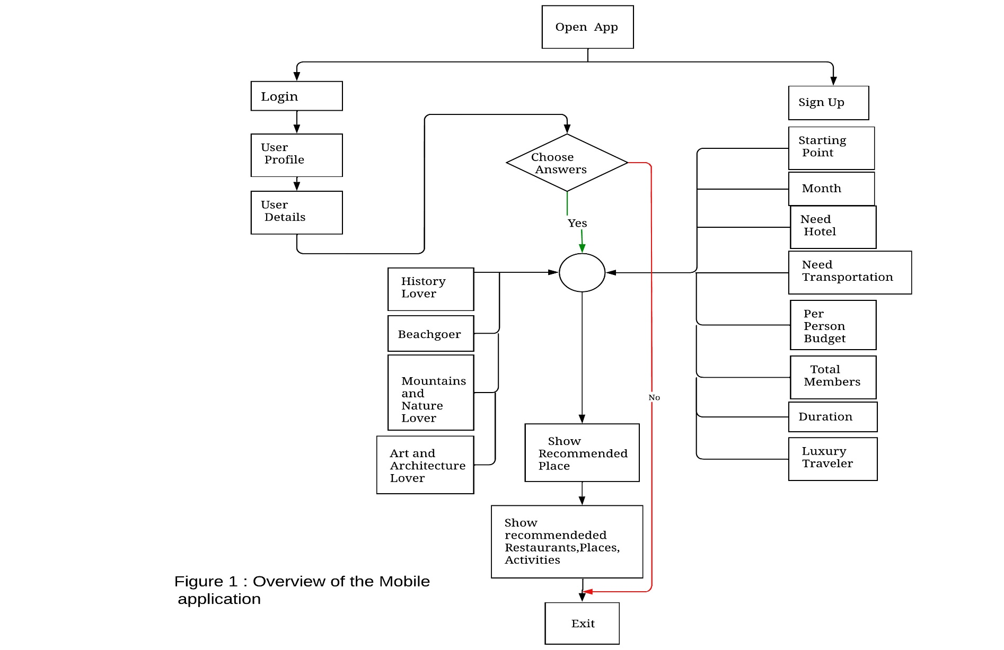
Methodology(Contd.)

Slide 11
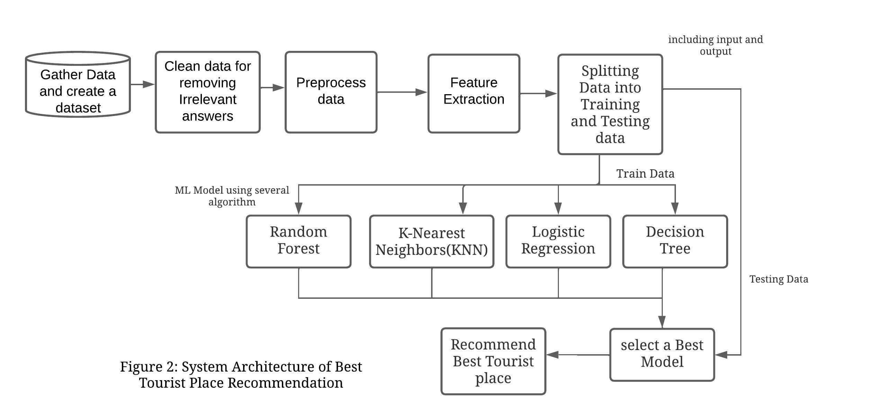
Methodology(Contd.)

Slide 12
Required Tools
Tools required to implement this system is given below :
Hardware requirements :
A Personal Computer
Internet Connectivity
A Smartphone
Software Tools:
Visual Studio Code
Flutter
Firebase
Google Map API
Jupyter Notebook with Python 3.x installed

Slide 13
Conclusion
The proposed method will be developed to build a Multi-criteria based Tourist place recommendation system for the Bangladeshi people
Data analysis will help us to recommend the best restaurants and foods, places to see, and activities to do in a particular place
In the Future we will try to add more features to our system to make it more efficient

Slide 14
References
[1] C. Comito, ‘Next: A framework for next-place prediction on location based social networks,’ Knowledge-Based Systems, vol. 204, p. 106 205, 2020, issn: 0950-7051. doi: https : / / doi . org / 10 . 1016 / j . knosys . 2020 . 106205. [Online]. Available: https://www.sciencedirect.com/science/article/ pii/S095070512030424X (cit. on p. 1).
[2] T. Ghani, N. Jahan, S. H. Ridoy, A. T. Khan, S. Khan and M. M. Khan, ‘Amar bangladesh - a machine learning based smart tourist guidance system,’ in 2018 2nd International Conference on Electronics, Materials Engineering Nano-Technology (IEMENTech), 2018, pp. 1–5. doi: 10.1109/IEMENTECH. 2018.8465377 (cit. on pp. 1, 2).
[3] H. Hu and X. Zhou, ‘Recommendation of tourist attractions based on slope one algorithm,’ in 2017 9th International Conference on Intelligent HumanMachine Systems and Cybernetics (IHMSC), vol. 1, 2017, pp. 418–421. doi: 10.1109/IHMSC.2017.102 (cit. on p. 1).

Slide 15
References
[4] V. Parikh, M. Keskar, D. Dharia and P. Gotmare, ‘A tourist place recommendation and recognition system,’ in 2018 Second International Conference on Inventive Communication and Computational Technologies (ICICCT), 2018, pp. 218–222. doi: 10.1109/ICICCT.2018.8473077 (cit. on p. 2).
[5] M. E. B. H. Kbaier, H. Masri and S. Krichen, ‘A personalized hybrid tourism recommender system,’ in 2017 IEEE/ACS 14th International Conference on Computer Systems and Applications (AICCSA), 2017, pp. 244–250. doi: 10.1109/AICCSA.2017.12 (cit. on p. 3).

Slide 16
The End
Thank You

